Slide 1
Wrapper Class

Slide 2
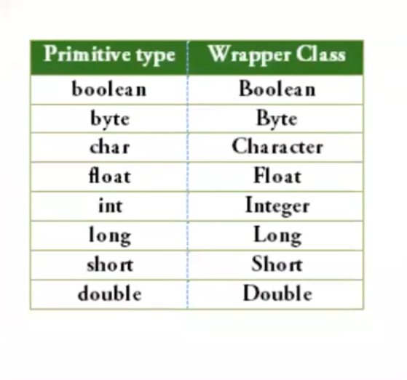
Wrapper class – it is used where we have to use integer but not as a non-primitive

